Slide 1
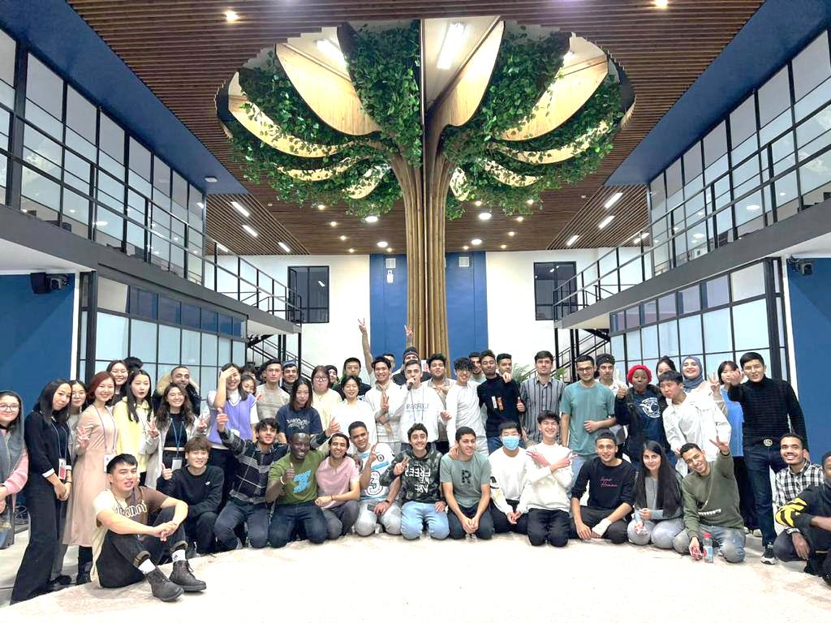
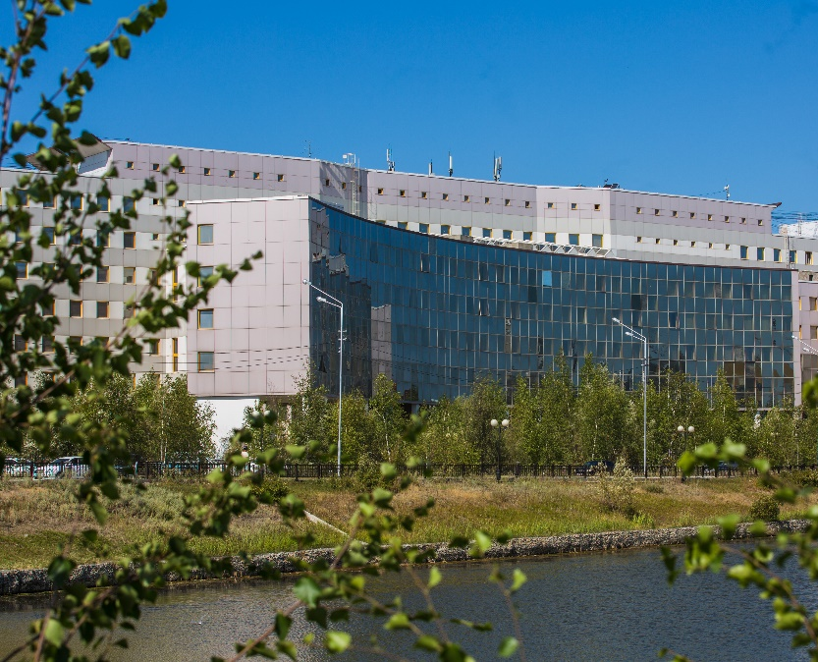
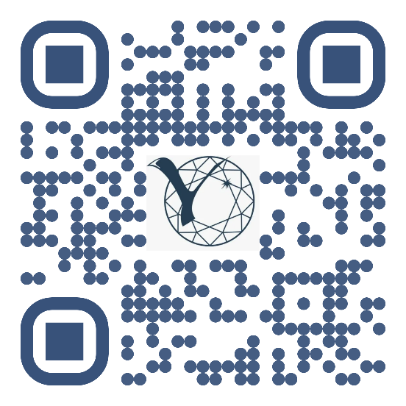
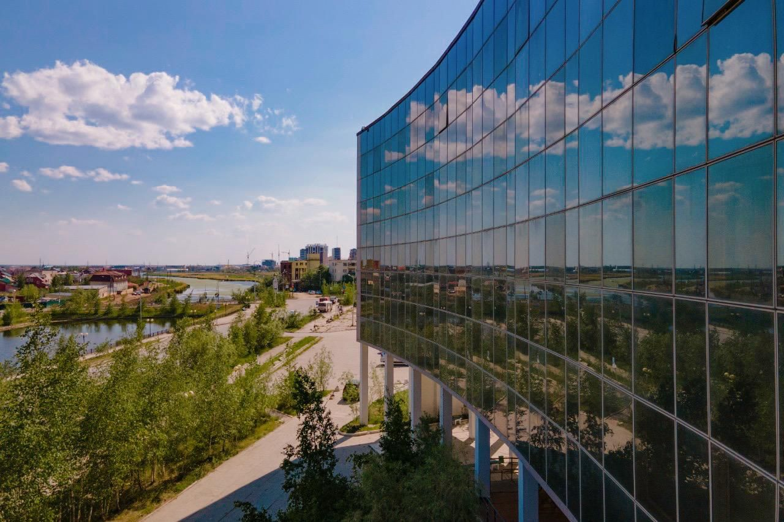
M.K. AMMOSOV NORTH-EASTERN
FEDERAL UNIVERSITY

Slide 2
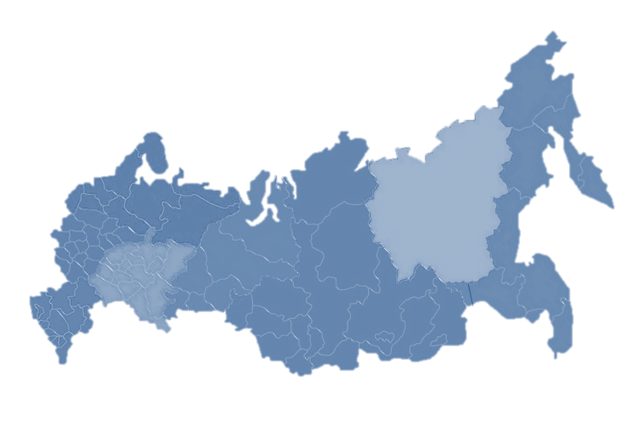
NORTH-EASTERN FEDERAL UNIVERSITY
25%
ENGINEERING, TECHNOLOGIES
AND TECHNICAL SCIENCES
14%
HEALTH
AND MEDICAL SCIENCES
>19 000
2%
ART AND CULTURE
students
15%
HUMAN SCIENCES
11%
MATHEMATICAL
AND NATURAL SCIENCES
from 52 regions of Russia
and 47 foreign countries
1%
AGRICULTURE
AND AGRICULTURAL SCIENCES
19
educational
units
5
research institutes
3
branches in
Neryungri, Mirny,
Anadyr
16%
SOCIAL SCIENCES
16%
EDUCATION AND PEDAGOGICAL SCIENCES

Slide 3
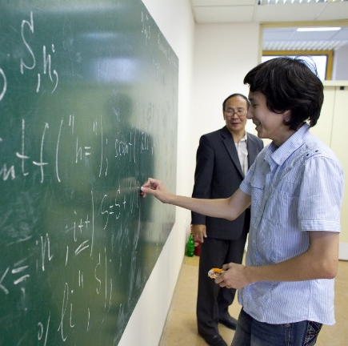
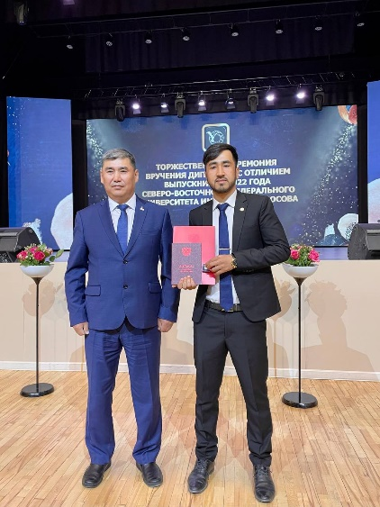
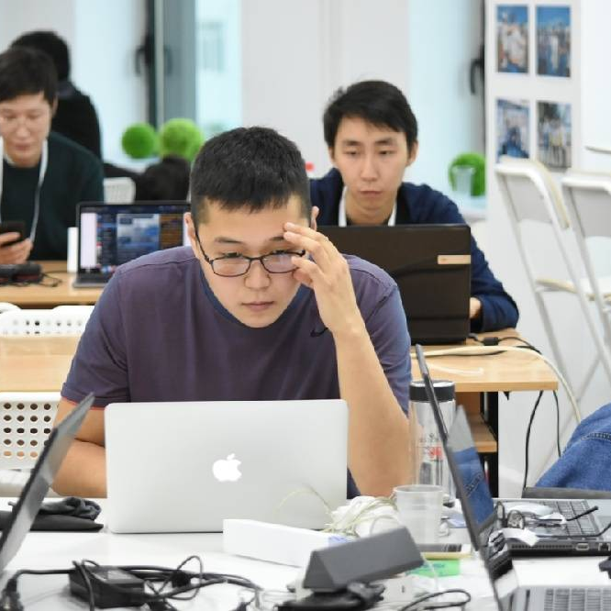
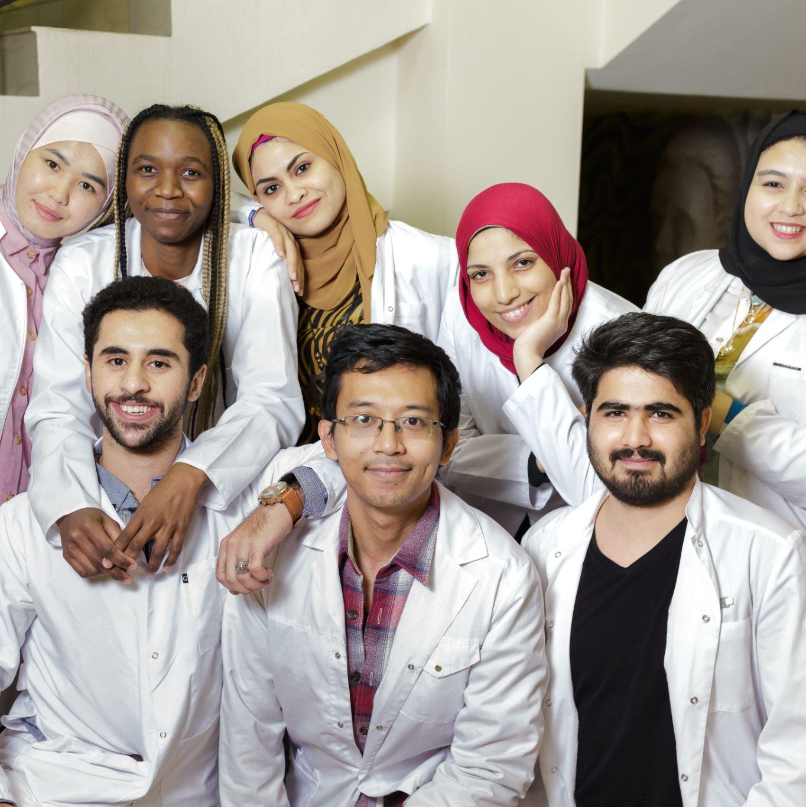
EDUCATIONAL PROGRAMS
INITIAL VOCATIONAL EDUCATION
SECONDARY VOCATIONAL EDUCATION
BACHELOR’S DEGREE
SPECIALTY’S DEGREE
MASTER’S DEGREE
POSTGRADUATE
DOCTORATE
RESIDENCY

Slide 4
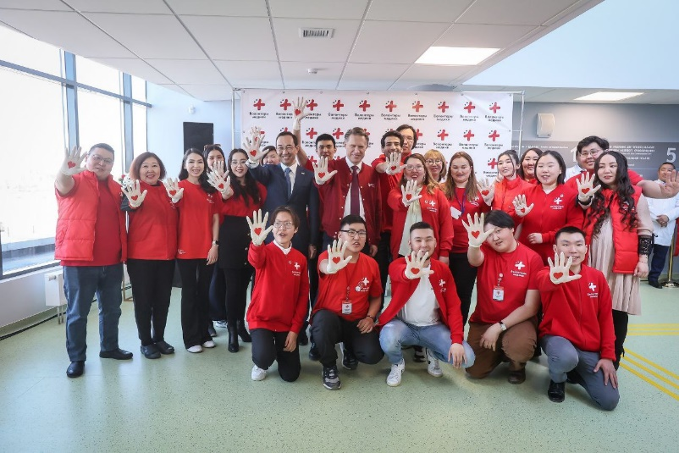
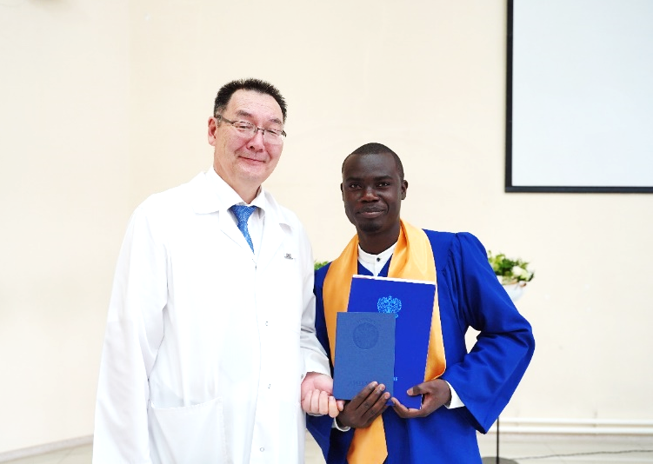
INSTITUTE OF MEDICINE
In total, more than 200 foreign students from the following countries study at the Medical Institute:
Azerbaijan Afghanistan Haiti Ghana Egypt Zimbabwe Indonesia Jordan Kazakhstan Cameroon Kyrgyzstan | China Congo Mongolia Namibia Nigeria Pakistan Somalia Sudan Tajikistan Turkmenistan Uganda Uzbekistan
General Medicine
Dentistry
Medical and preventive care
Pediatrics
Nursing

Slide 5
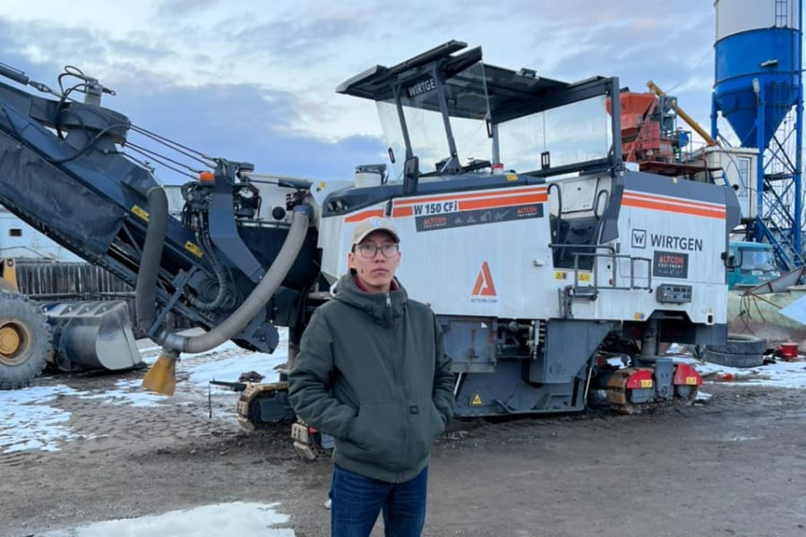
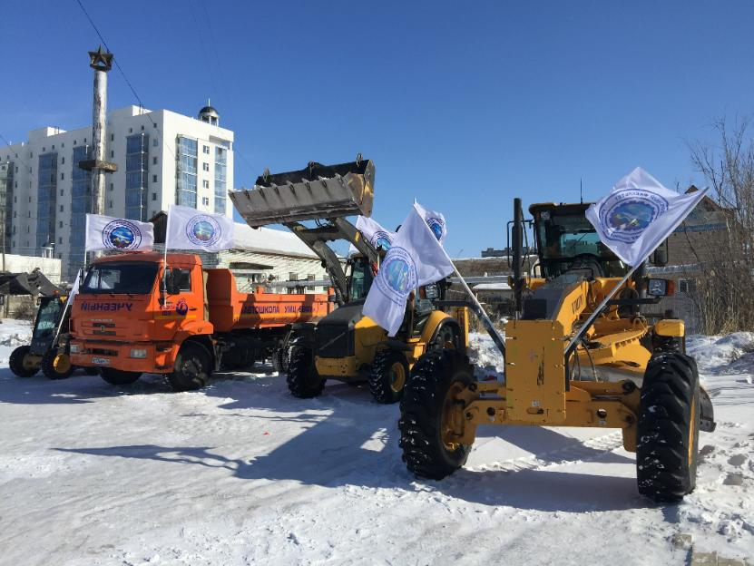
FACULTY OF ROAD CONSTRUCTION
BACHELOR’S DEGREE
Construction
Construction operation, repair and maintenance of highways, bridges and tunnels
Mechanical engineering
Technology of transport processes
Ground transportation and technological complexes
Professional training
MASTER'S DEGREE
Construction
Management
Technology of transport processes
Professional training
Notes:
2 колонки два кружка и две фотки
Добавить 1 проект
2 фотки справа

Slide 6
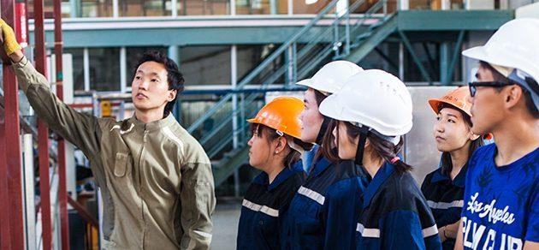
INSTITUTE OF ENGINEERING & TECHNOLOGY
BACHELOR’S DEGREE
Construction
Technology of logging and woodworking industries
Land management and cadastres
Architecture
Applied mechanics
MASTER'S DEGREE
Design and construction of buildings and structures in the Far North
Construction materials and technologies in the permafrost zone
Land management and cadastres
Energy Saving and Energy Efficiency in Buildings

Slide 7
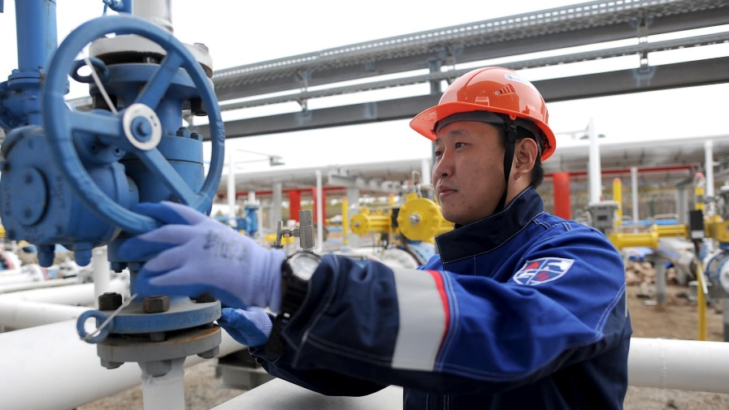
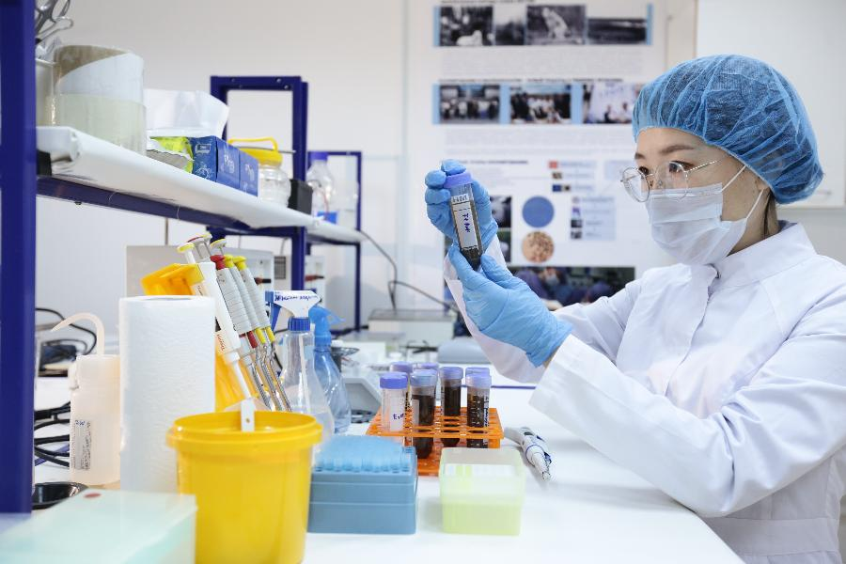
FACULTY OF GEOLOGY AND SURVEY
INSTITUTE OF NATURAL SCIENCES
Oil and gas equipment and technologies (Technology for drilling oil and gas wells)
Oil and gas equipment and technologies (main pipelines and gas and oil storage facilities)
Oil and gas business
Ecology and environmental management (Nature management)
Chemical Technology

Slide 8
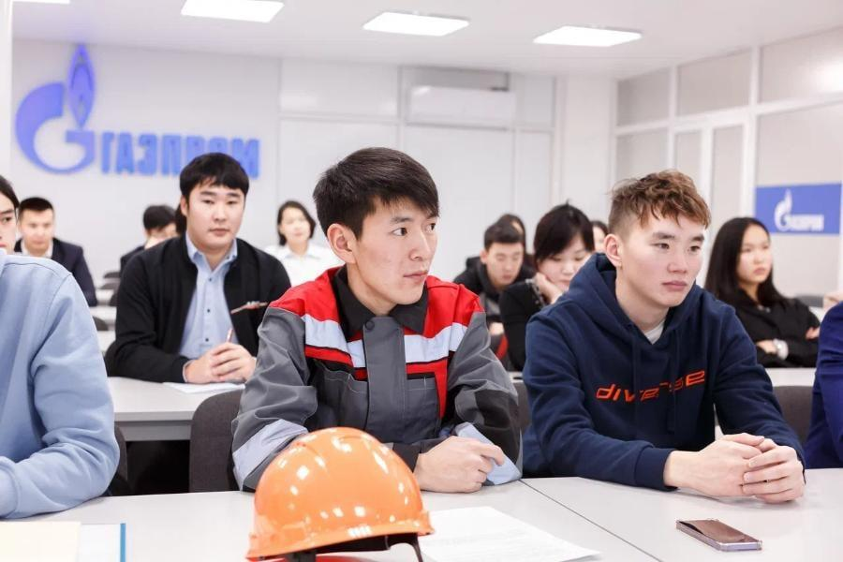
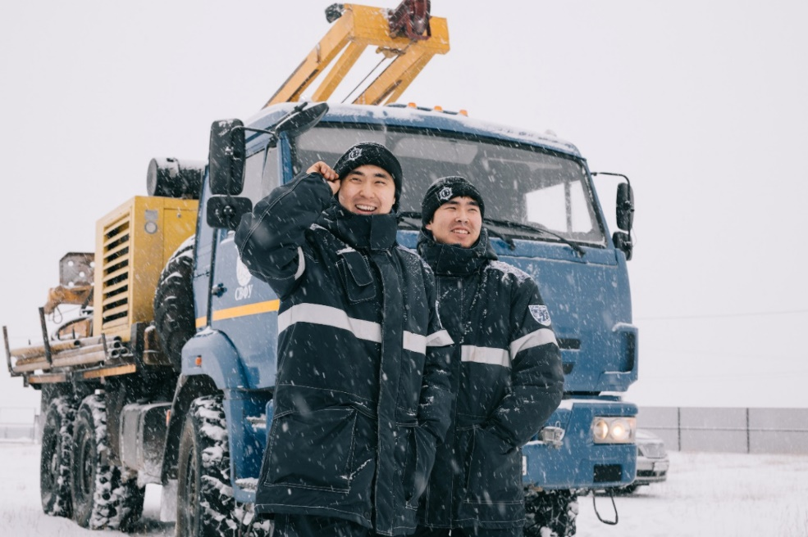
MINING INSTITUTE
BACHELOR‘S DEGREE
Technosphere safety
MASTER’S DEGREE
Technosphere safety
SPECIALIST’S DEGREE
Mining:
Underground mining of ore deposits
Open pit mining
Mine and underground construction
Mining machinery and equipment
Notes:
Объединить широкогеномные и геномику.

Slide 9
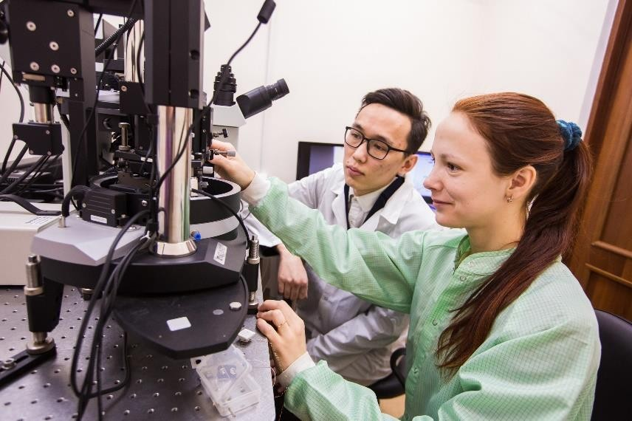
INSTITUTE OF PHYSICS AND TECHNOLOGIES
BACHELOR’S DEGREE
Physics
Radiophysics
Radiotechnics
Heat power engineering and heat engineering
Standardization and Metrology
Power and Electrical Engineering
MASTER’S DEGREE
Physics
Radiophysics
Modern materials in the energy sector and renewable energy (under the double diploma program with the Cergy-Pontoise University(France))
Physics. Convergence: Advanced Technologies
Radiotechnics

Slide 10
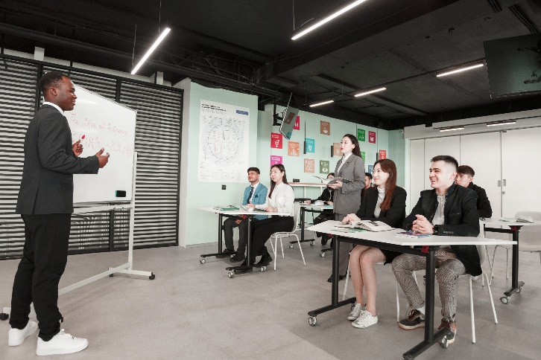
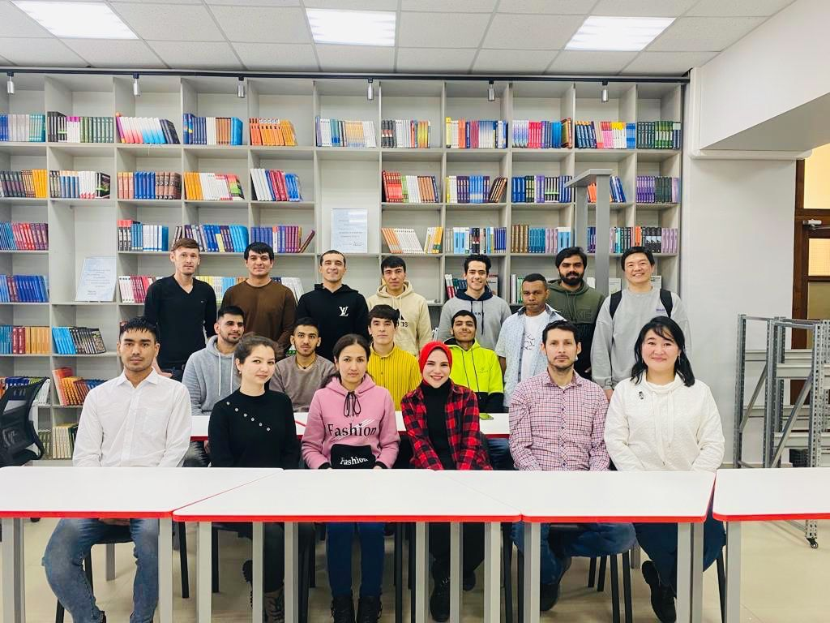
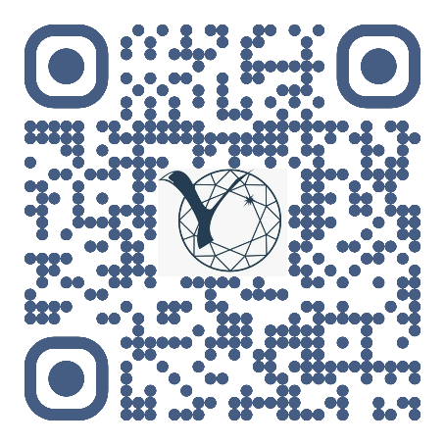
THE CENTER OF INTERNATIONAL EDUCATION
Preparatory courses “Russian as a foreign language”
In person and remotely
From 6,000 to 18,000 rubles per month
Free short-term online Russian language courses for schoolchildren
Test of Russian as a Foreign Language (TORFL) - an international exam to determine the level of proficiency in the Russian language
To apply, scan the QR code

Slide 11
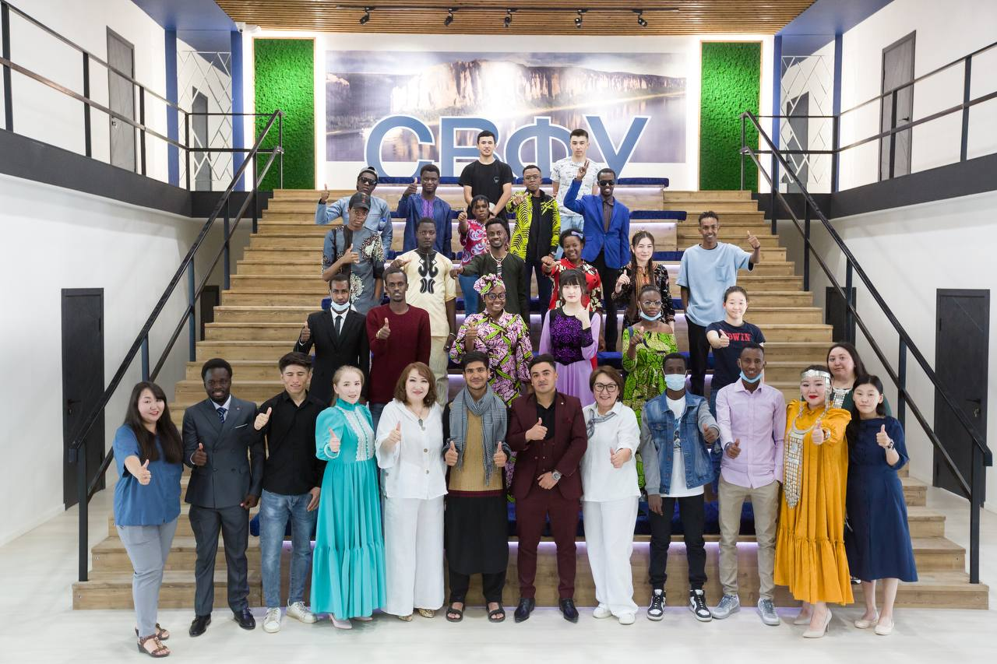
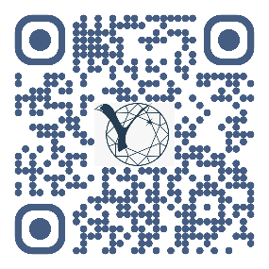
FACULTY OF PRE-UNIVERSITY EDUCATION AND VOCATIONALIZATION
Preparation for training in the main educational programs in the following profiles:
Engineering
Humanitarian
How to apply
Economic
Science
General education
Russian Government Scholarship
On a contract basis
118 000 р.
Medical

Slide 12
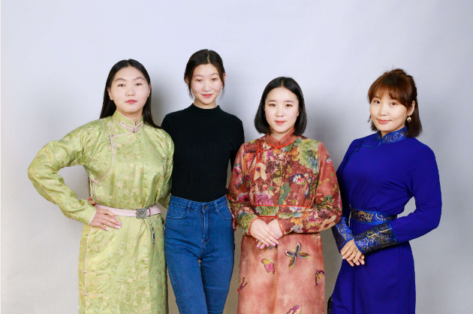
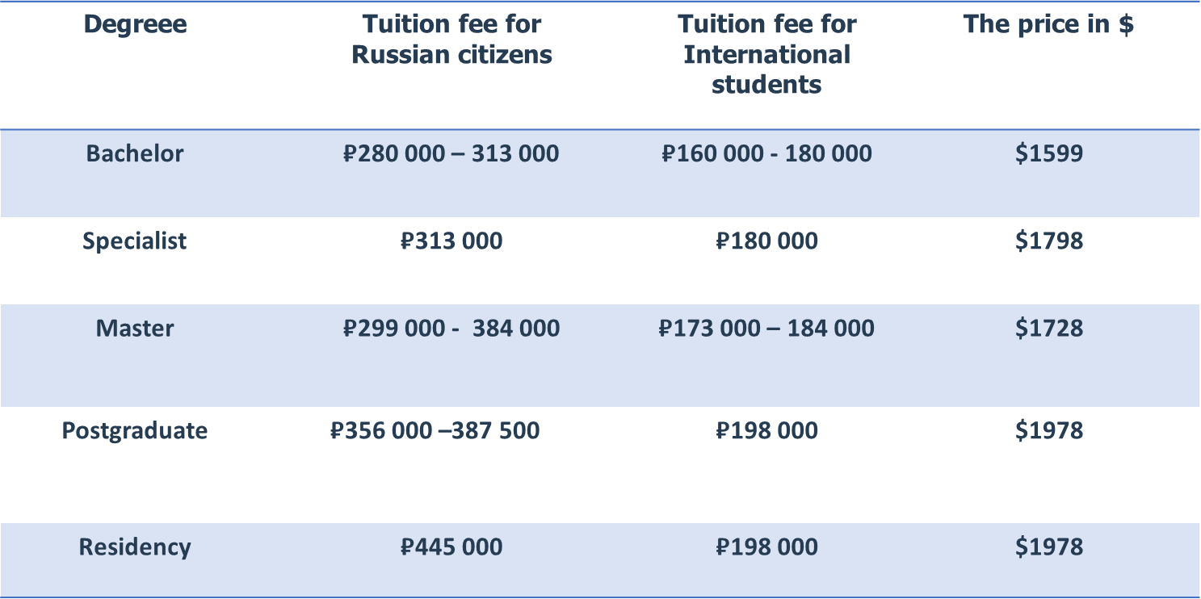
Tuition fees for the 2023/24 academic year
Only for international students the university offers grants covering up to 60% of the cost of study

Slide 13
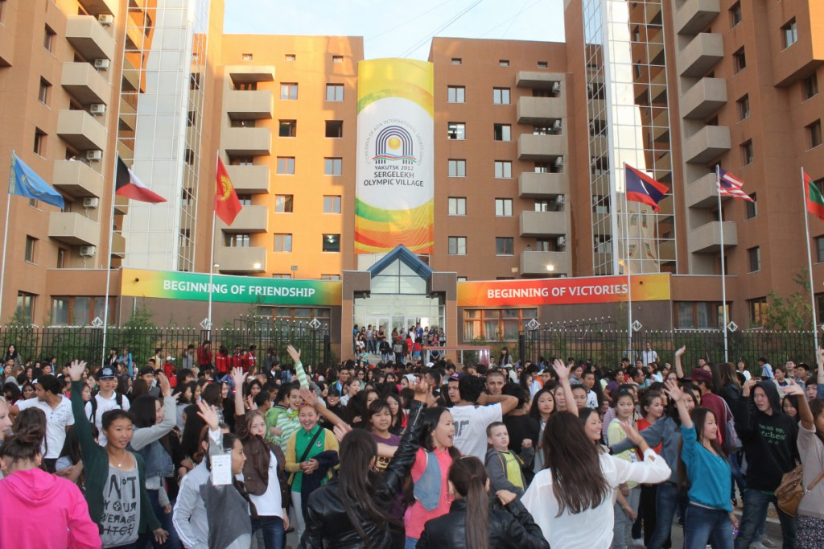
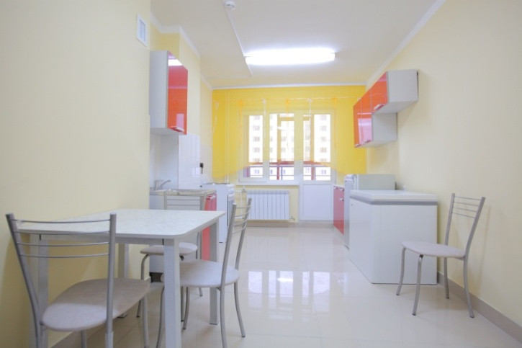
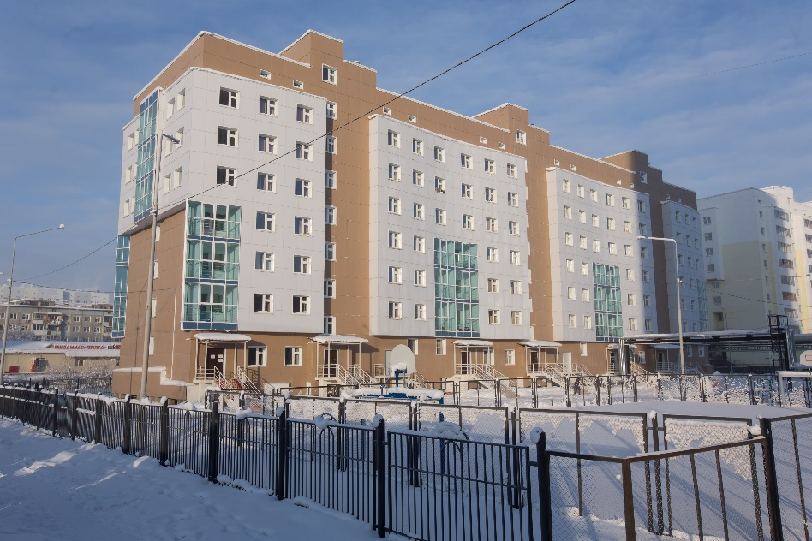
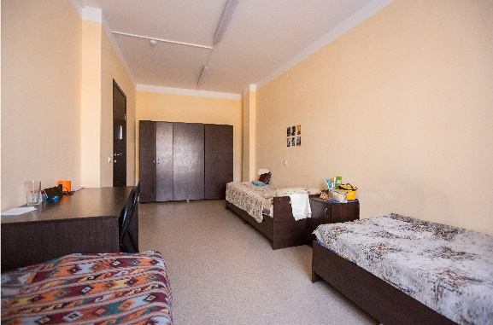
ACCOMODATION, NEFU CAMPUS
BEST CONDITIONS FOR UNFORGETTABLE STUDENT LIFE
15
dormitories of the Sergeleekh campus
>5,5
thousand students living in dormitories
Student dormitory No. 9/2 is the finalist of the All-Russian competition for the best dorms of 2016
Cost of accommodation:
1237 rubles per month = 13 USD

Slide 14
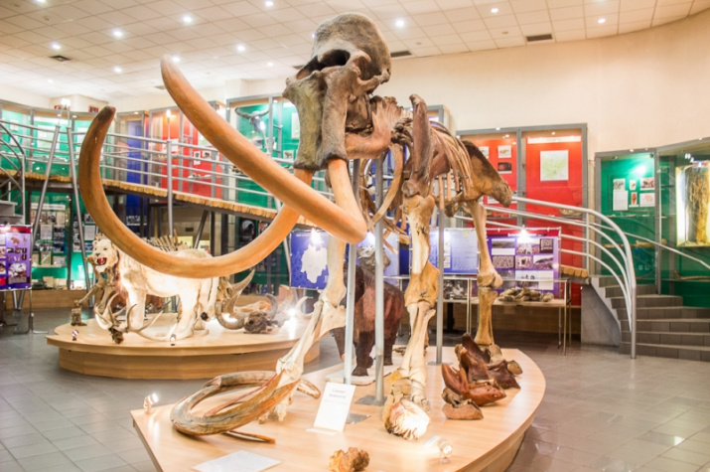
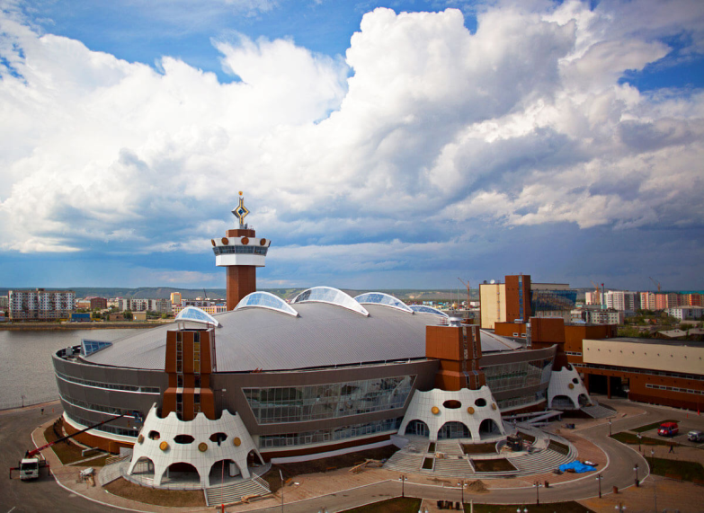
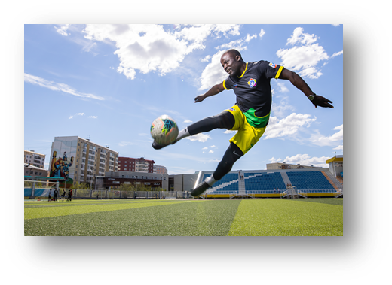
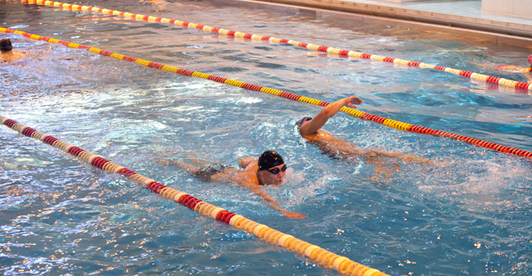
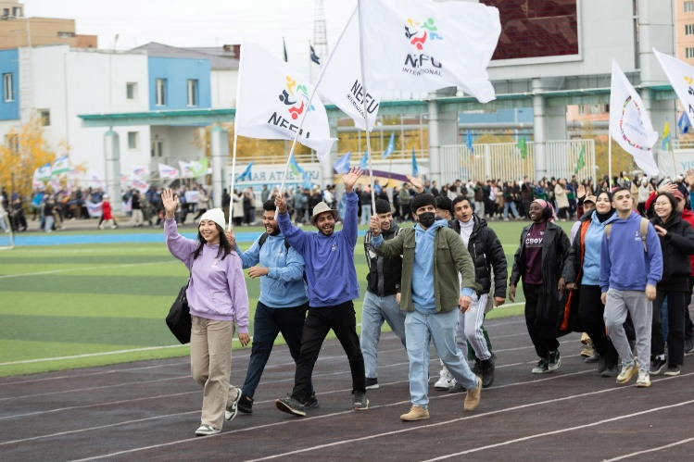
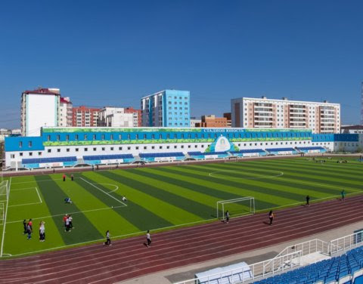
There is everything you need for living, study and leisure in university campus:
Cultural centre «Sergelyakhskie ogni»
Sports complex «Triumph»
Athletics arena «Younost’»
Gyms
Swimming pool «Dolgun»
Ski base
Greenhouse
Museums
Café and restauraunts
Shops and other!

Slide 15
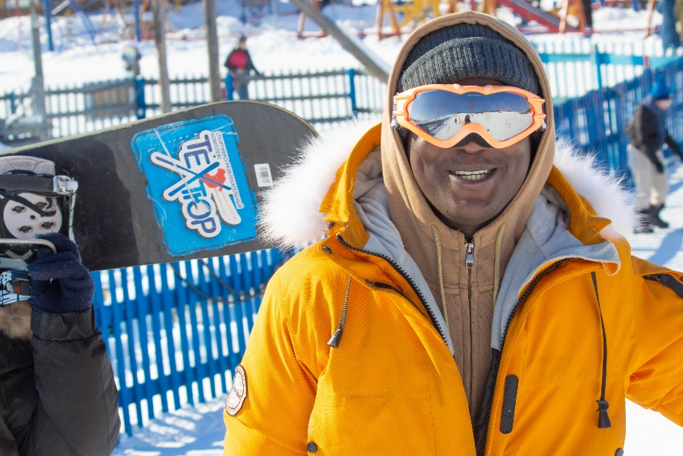
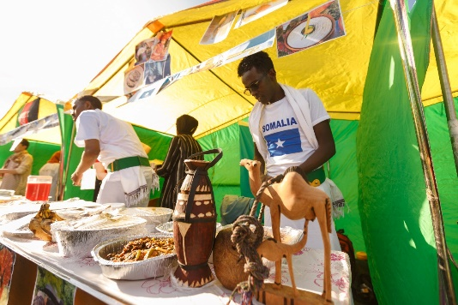
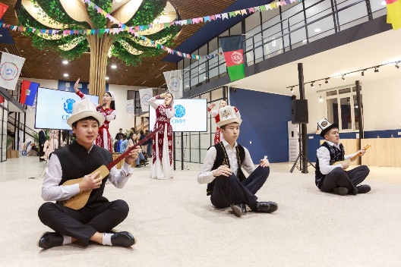
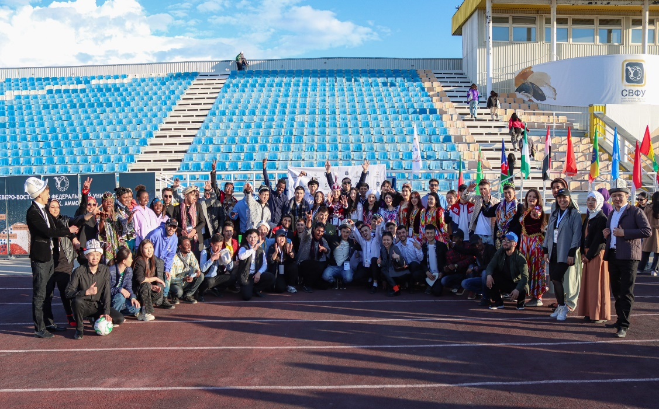
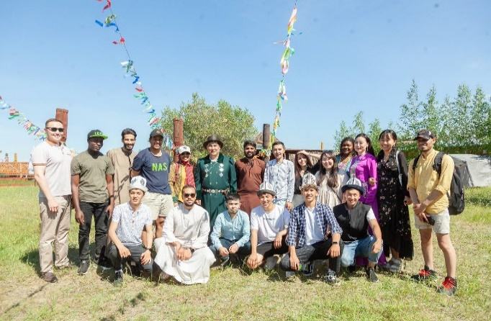
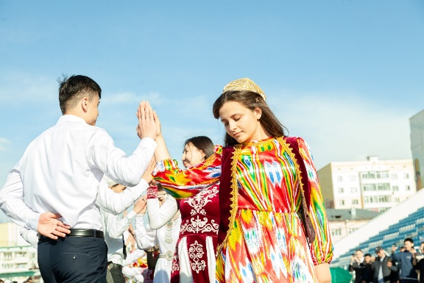
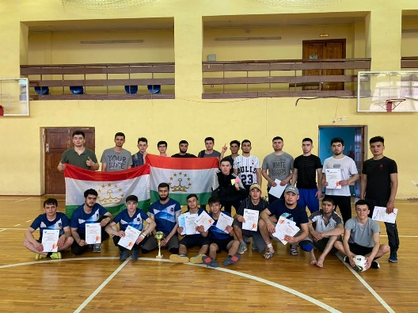
Extracurricular activities
Club NEFU International
is a student club that helps students develop intercultural communication and quickly adapt to study and life in Yakutsk.
The student club, together with the Department of International Cooperation, organizes and conducts sociocultural, scientific, and sports events.

Slide 16
How to get the state scholarship ?
https://education-in-russia.com/

Slide 17
Applicants are registered in the https://education-in-russia.com/ system and download documents
Competitions are held on the basis of the Representation of Rossotrudnichestvo in the country (Russian Center for Science and Culture - RCSC)
Winners will be enrolled in Russian universities without passing other entrance exams at the university
If NEFU is indicated in the application form as priority, the probability of enrollment is very high.

Slide 18
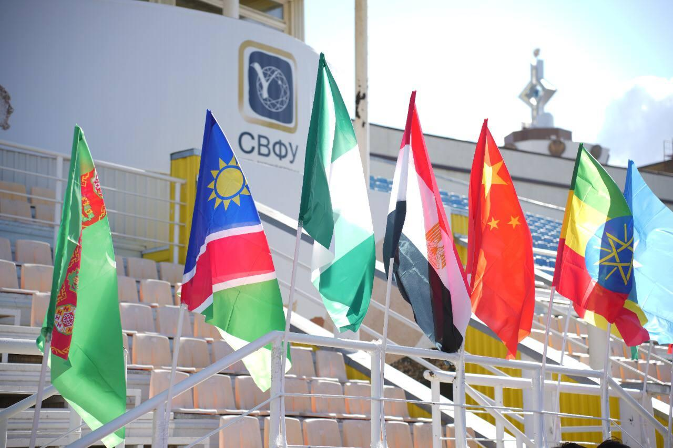
HOW TO CONTACT US
M.K. Ammosov North-Eastern Federal University
Russian Federation
Republic of Sakha (Yakutia), Yakutsk, 677000
Kulakovsky street 42
Tel: +7 4112 36 14 53
E-mail: international@s-vfu.ru
https://www.s-vfu.ru/
https://t.me/svfunews
https://vk.com/ums_svfu
https://www.youtube.com/user/videosvfu

